Slide 1
Annual Meeting April 25, 2023 League of Women Voters of Licking County
Notes:
To Take:
Clicker
Computer
Hottinger handout
Worksheets
Copies of Bylaws and Committees

Slide 2
Agenda
President’s Report
Approval of Minutes of April 28, 2022
Treasurer’s Report
New Business
Proposed Budget 2023-2024 Jane Wilken
Slate of Nominations Jim Bidigare
Program (Action and Advocacy) Jim Bidigare

Slide 3
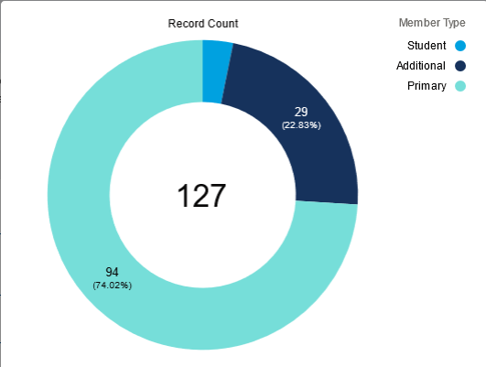
President’s Report Membership
94 Primary
29 Additional
4 Students

Slide 4
President’s Report Membership
Restructuring Dues and Donations
Dues will remain at current levels but also
Include an option to Pay What you Can and
Encourage larger donations in specified categories

Slide 5
Encouraging Enhanced Support
$50 Susan B. Anthony ADVOCATE
$100 Sojourner Truth SUSTAINER
$250 Alice Paul PATRON
$500 Carrie Chapman Catt CHAMPION

Slide 6
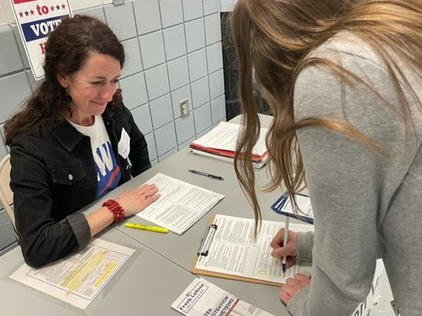
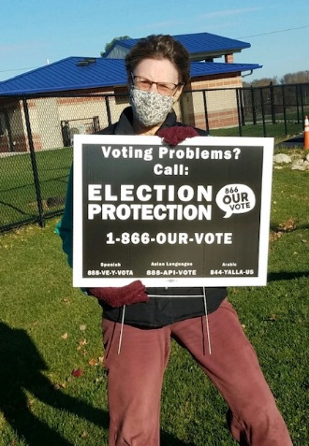
President’s Report
Survey of Members Report
Susan Studer King
Mary Tuominen

Slide 7
Survey of Members

Slide 8
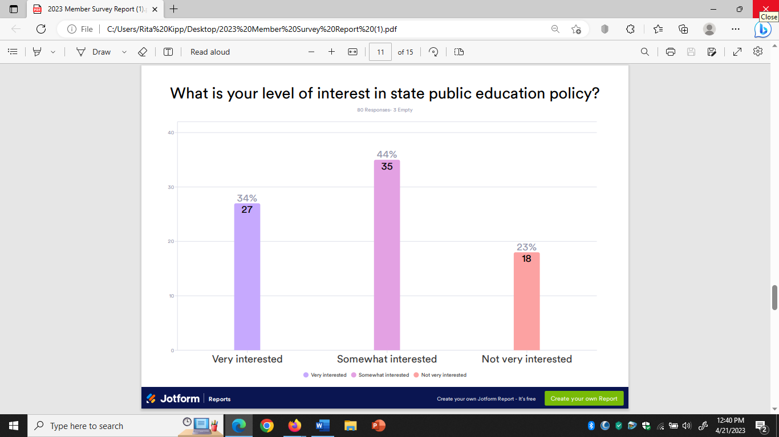
Survey of Members

Slide 9
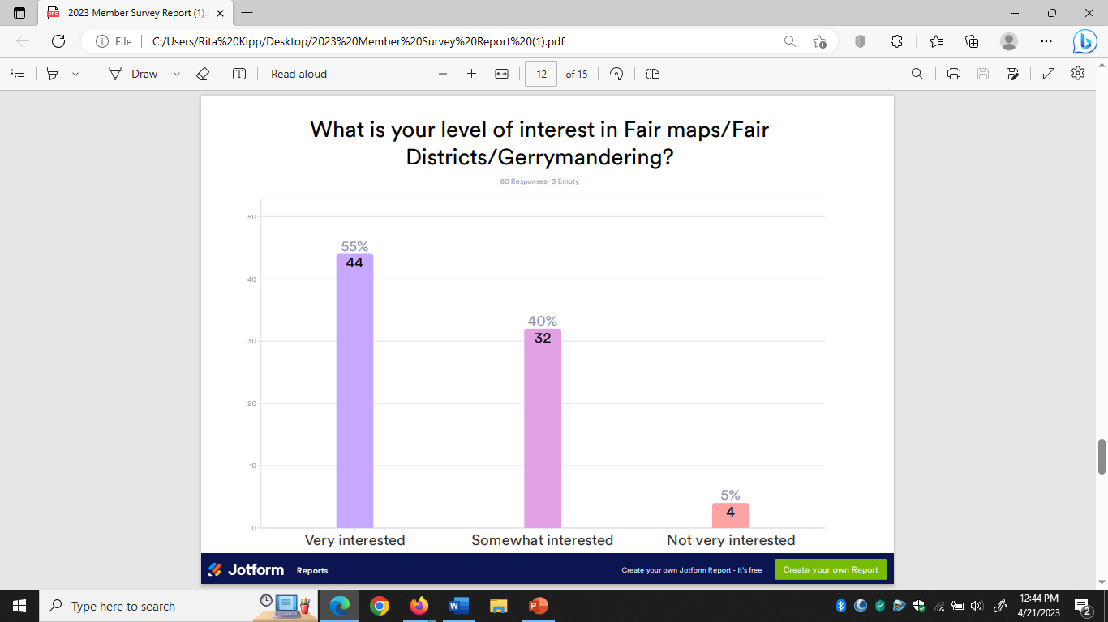
Survey of Members

Slide 10
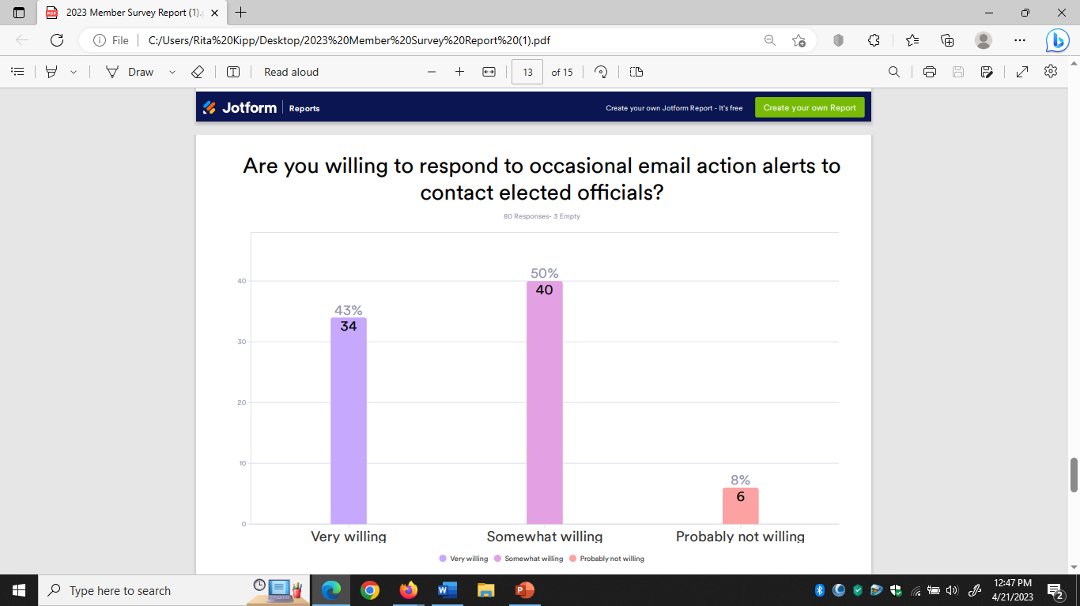
Survey of Members

Slide 11
President’s Report High School Voter Registration Spring 2023
12 High Schools
56 Volunteers
583 Voters Registered

Slide 12
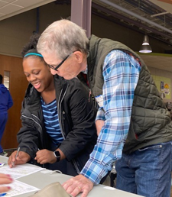
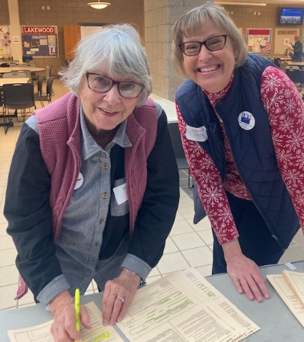
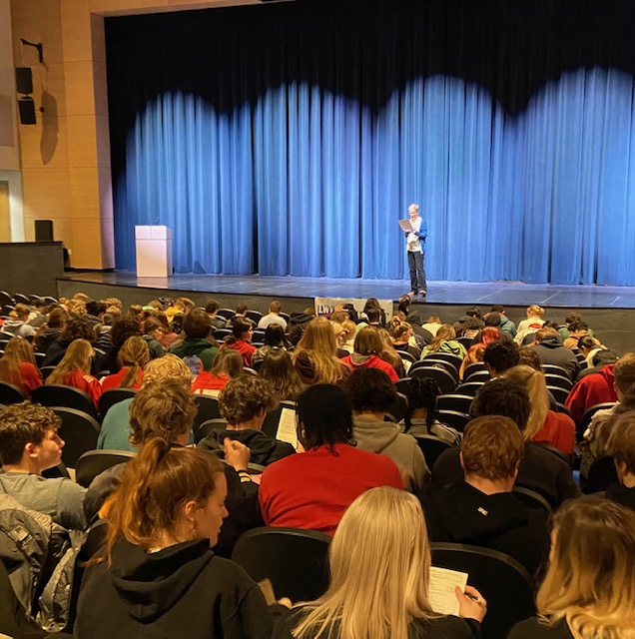
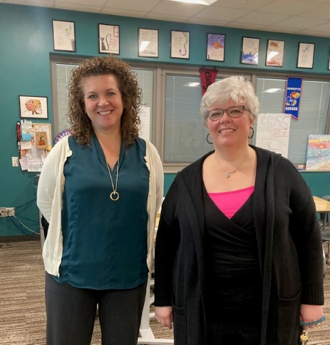
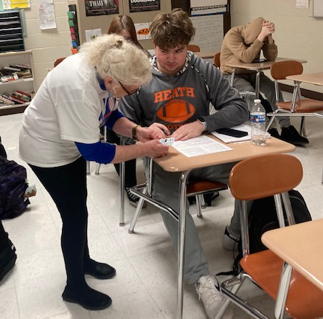
President’s Report Voter Registration

Slide 13
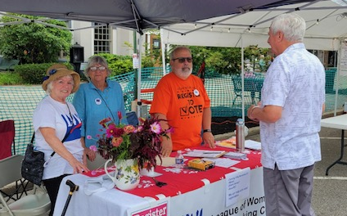
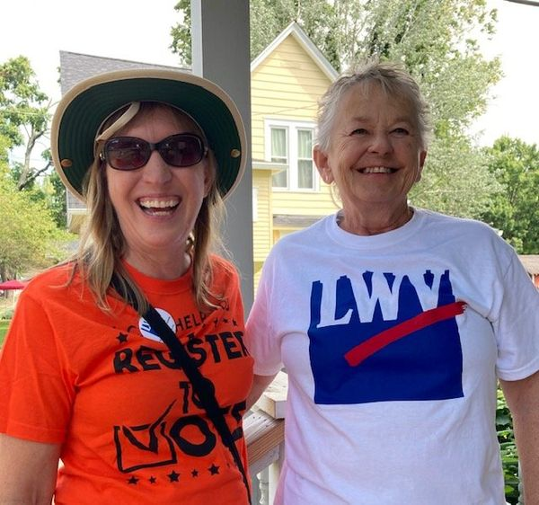
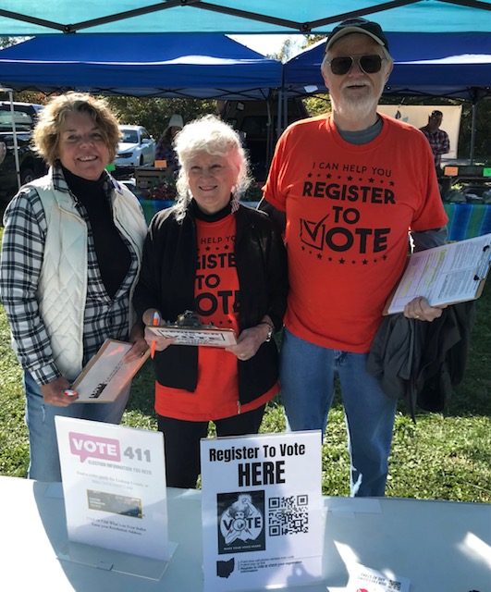
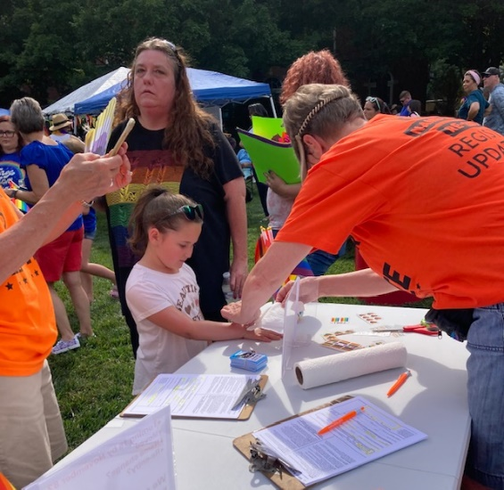
President’s Report
Voter Registration and Information

Slide 14
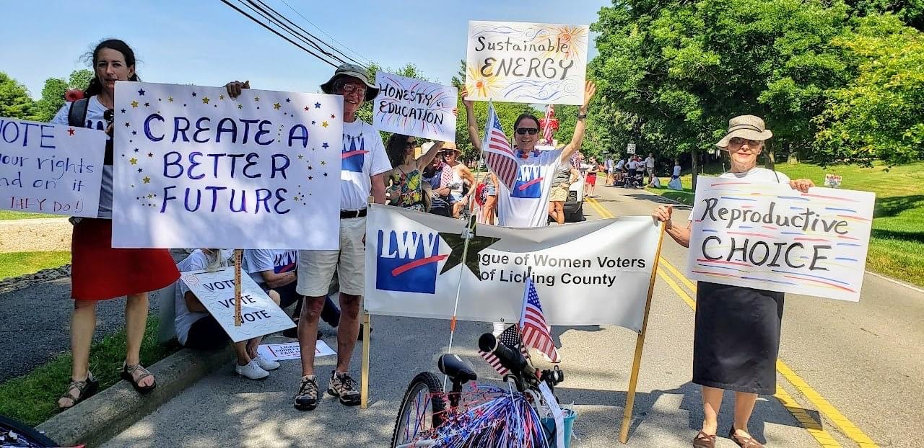
President’s Report Fourth of July Festival

Slide 15
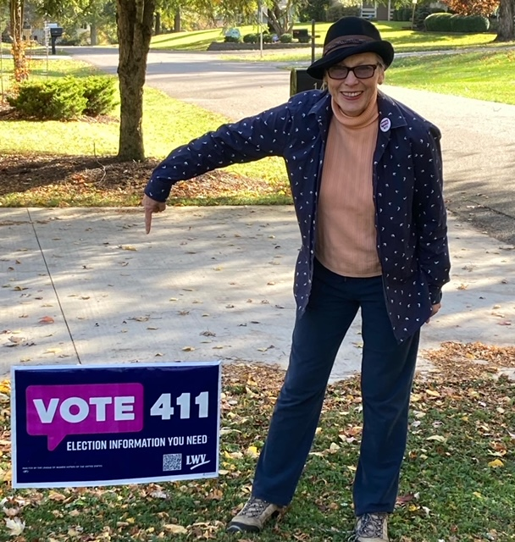
President’s Report
Online Voter Guide: Vote411
Thank you Laura Joseph!

Slide 16
President’s Report Educational Events
Panel: the New Voting Laws March 2023
With Denison University
Ranked Choice Voting
April 2022

Slide 17
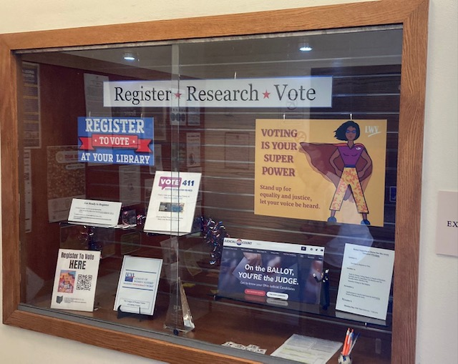
President’s Report Educational Events
Granville Public Library Display on Voting
October 2022

Slide 18
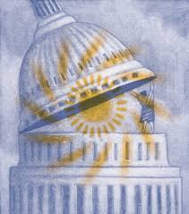
Observer Corps
Coordinator: Lyn Robertson
Board of Health
Elizabeth Dillenburg
County Commissioners
Irene Kennedy
Joe Kenndey
Dave Lipstreu
Judy Stansbury
Karen Semer (sub)

Slide 19
Observer Corps
Coordinator: Lyn Robertson
Board of Education, Granville
Barb Lechner
Susan Richardson
Board of Elections
Jerry Griffin
Granville Village Council
Diana Beardsley

Slide 20
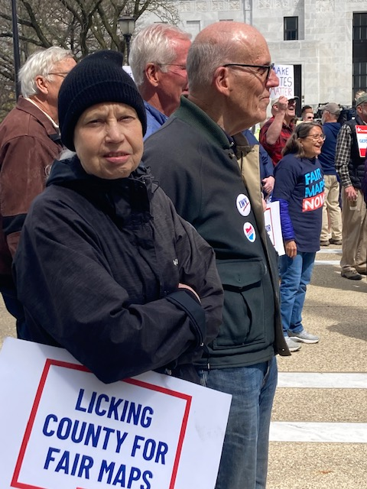
President’s Report Advocacy and Action
Joint Rally on Fair Maps -
April 2022
Granville Village Proposal on Residential Solar
Defending Students’ Right to Vote

Slide 21
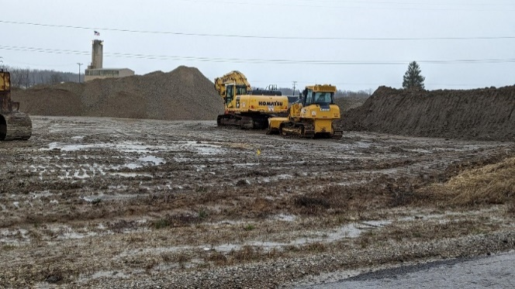
President’s Report Advocacy and Action
Asphalt Plants Proposed in Alexandria
Letters to the Editor, EPA, Planning Commission, St. Albans Twp. Trustees
Licking County Board of Elections
Board procedures

Slide 22
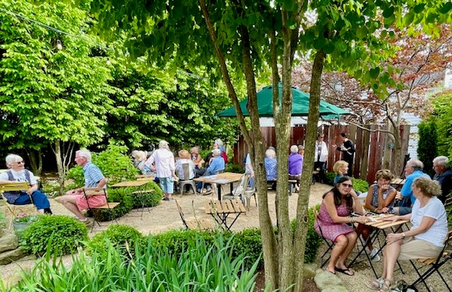
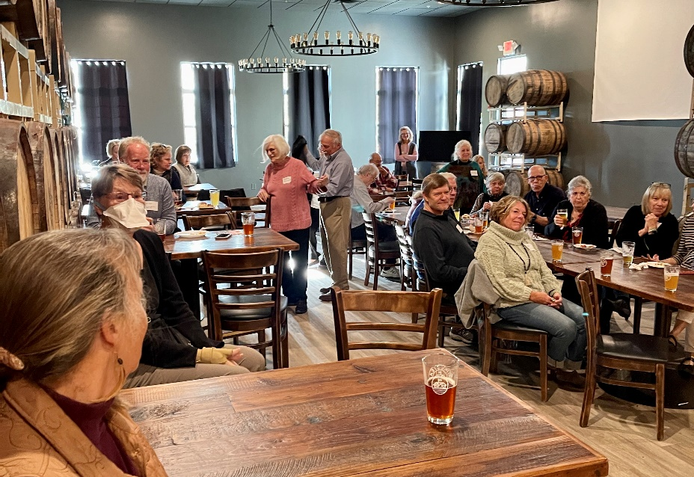
President’s Report
Connecting with Each Other
May at Seek no Further Cidery
October with American Gypsy

Slide 23
Donors May 2022– April 2023
Carol & Ken Apacki
Jim Bidigare
Robert Blomeyer
Cathy Burczak
Chris & Sue Cherney
Marsha Crawford
Jerry Griffin
Susan Haas
Tom Hall
Jane Harf
Linda Harman
Becky Hoover
Laura Joseph
Susan & Zaven Karian
Susan Studer King
Rich & Rita Kipp
Barbara and Ken Klatt
Tracee Laing
& Paul Hammond
Barbara Lechner
Jacque Morgan & Rick Smithers
Linda Mossholder
Nationwide Insurance
Michelle Newman
Judy Stansbury
Mary Lee & Richard
Van Meter
United Way of Licking Co
Emily & Kaleb Vermillion
Patricia Wanat
Jane Wilken
Pamela Wilson
& Chip Crawford
Notes:
QESTIONS on Presidents Report???

Slide 24
Motions to Approve and New Business
Minutes of April 28, 2022
Treasurer’s Report 2022-2023
Budget for 2023-24
Election of Leaders
Action and Advocacy Program 2023-2025

Slide 25
Treasurer’s Report
For the Period Ending March 31, 2023
Revenue $9,223
Donations $2,877
Membership Dues $5,960
Expenses $7,102
Membership LWVUS $2,896
Membership LWVO $2,263
Excess Revenue $2,121
Total Cash Balance $15,826

Slide 26
Proposed Budget 2024-2025
Total Revenue $10,210
Donations $3,000
Membership Dues $7,210
Total Expenses $10,110
Membership LWVUS $3,470
Membership LWVO $2,710
Events $ 500
Excess Revenue $ 100

Slide 27
Leadership Nominations
President, Mary Tuominen 2025
Secretary, Karen Semer 2025
Treasurer, Jerry Griffin 2025
Nominating Committee
Jim Bidigare, Chair 2024
Rita Kipp 2024
Heather Rhodes 2024

Slide 28
LWVLC Leadership 2023-2024
Elected Directors
President Mary Tuominen 2025
Vice President Emily Vermillion 2024
Secretary Karen Semer 2025
Treasurer Jerry Griffin 2025
Voter Education Laura Joseph 2024
Nominating Committee
Jim Bidigare 2024 (Chair)
Rita Kipp 2024
Heather Rhodes 2024
Appointed Directors
Carol Apacki Educational Events
Susan Studer King Website
Pam Wilson Liaison with LWVO and LWVUS

Slide 29
Program for Advocacy and Action 2022-2023 The Campaign for Making Democracy Work®
Includes ensuring a free, fair and accessible electoral system for all eligible voters by focusing on:
Voting Rights
Improving Elections
Campaign Finance/Money in Politics
Redistricting

Slide 30
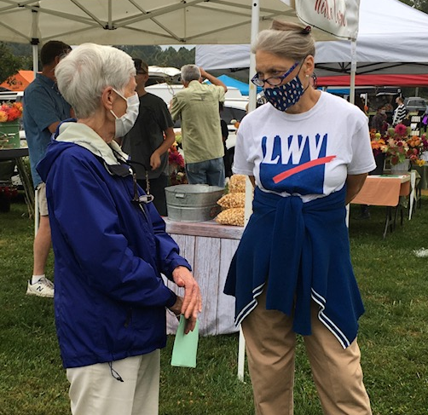
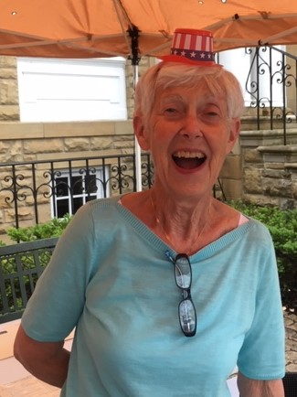
Thank you!
Jane Wilken Jane and Rita
Working the Farmers’ Market

